Slide 1
Process Lifecycle Analyzer & Scheduler Simulator
Operating Systems Hackathon
Team Members:
Tanusri (2420030105)
Pranusree (2420030658)
Ranan Magdala (2420030744)
Surya Teja (2420030326)

Slide 2
Project Abstract
Concept
It shows how a process moves through stages like
new, ready, running, waiting, and terminated in an
operating system.
Algorithm
Take processes as input, schedule them using an algorithm, execute while updating states, and repeat until all are completed..
Simulator Design
Calculation
Takes process inputs, schedules them via an algorithm,
executes while tracking states, outputs performance results
Turnaround Time (TAT) = Completion Time − Arrival Time..
Learning Outcome
Applications
Understand process lifecycle and evaluate CPU scheduling
performance using key metrics.
.
Used in operating systems to optimize CPU scheduling and
improve system performance.

Slide 3
Problem Statement:
Build a tool that monitors real-time process lifecycle events (creation, execution, termination) and simulates different CPU scheduling algorithms (FCFS, SJF, Round Robin) on the observed workload. The system should compare scheduling efficiency and visualize metrics like turnaround time, waiting time, and CPU utilization
In operating systems, understanding how processes move through different lifecycle stages and how CPU scheduling algorithms work is often complex and not visually clear.
Students and developers find it difficult to compare algorithms like FCFS, SJF, and Round Robin in terms of performance. There is no simple tool that clearly shows process state transitions and calculates key metrics like waiting time and turnaround time in an easy-to-understand way.
Hence, a simulator is needed to visualize process execution, analyze scheduling performance, and improve learning and system efficiency.

Slide 4
Project Overview :
The Process Lifecycle Analyzer & Scheduler Simulator is a tool designed to simulate how processes move through different stages in an operating system.
It demonstrates how CPU scheduling algorithms like FCFS, SJF, and Round Robin manage process execution.
The system takes process details as input, schedules them using selected algorithms, and visually tracks their states (new, ready, running, waiting, terminated).
It also calculates important performance metrics such as waiting time, turnaround time, and CPU utilization.
This project helps in better understanding of OS concepts and improves analysis of scheduling efficiency in real-time scenarios.

Slide 5
Core Principles :
Process Lifecycle Management → Track process states (new, ready, running, waiting, terminated).
CPU Scheduling → Apply algorithms like FCFS, SJF, and Round Robin.
Efficient Resource Use → Optimize CPU utilization and minimize idle time.
Performance Analysis → Calculate waiting time, turnaround time, etc.
Visualization → Clearly display execution flow (like Gantt chart).

Slide 6
Advantages:
Easy understanding of process lifecycle and scheduling concepts
Helps compare different CPU scheduling algorithms
Improves analysis using performance metrics
Provides visual representation (Gantt charts)
Useful for students and learning purposes
Limitations:
May not handle real-world complex scenarios
Limited to predefined scheduling algorithms
Simulation results may differ from actual systems
Requires proper input for accurate results
Less focus on advanced OS features

Slide 7
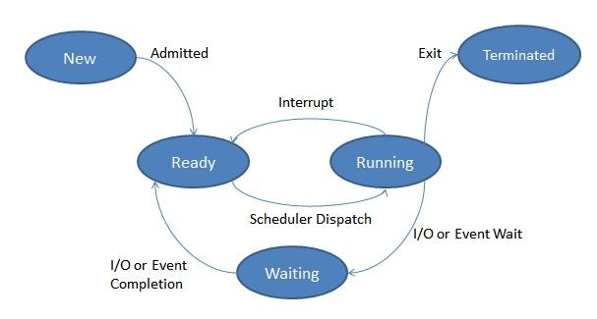
Project Workflow:

Slide 8
Input Processes ↓ Ready Queue ↓ Select Scheduling Algorithm ↓ Process Execution ↓ State Update (Running → Waiting/Terminated) ↓ Repeat Until Complete ↓ Display Results

Slide 9
Real World Examples
CPU Task Management
Banking System Processing Handles multiple transactions
efficiently
Online Food Delivery Apps Manages order processing and
delivery tasks efficiently
OS schedules apps like browser and music player

Slide 10
Calculation & Formulae:
Turnaround Time (TAT) = Completion Time − Arrival Time
Waiting Time (WT) = Turnaround Time − Burst Time
Average WT = Total Waiting Time / Number of Processes
Average TAT = Total Turnaround Time / Number of Processes
CPU Utilization = (CPU Busy Time / Total Time) × 100

Slide 11
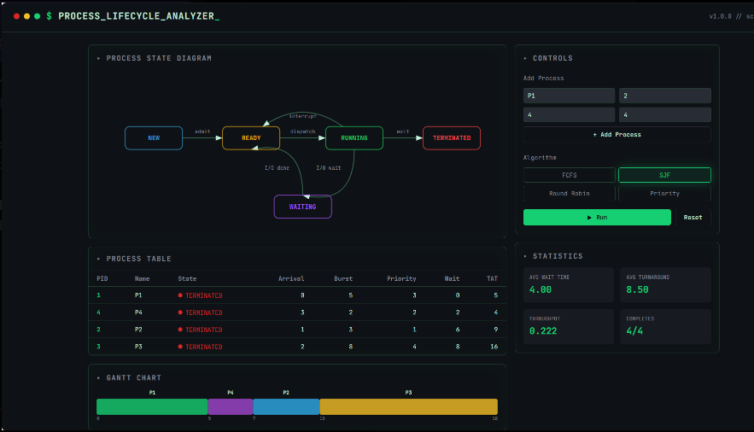
Output:

Slide 12
Conclusion :
The Process Lifecycle Analyzer & Scheduler Simulator provides a clear understanding of how processes are managed and executed in an operating system. It helps visualize different scheduling algorithms and analyze their performance using key metrics.
By simulating real-time process execution, the project improves learning, comparison, and optimization of CPU scheduling techniques. Overall, it is a useful tool for both educational purposes and basic system performance analysis.
It enhances problem-solving skills by applying OS concepts practically.
It provides a foundation for developing advanced system-level applications.

Slide 13
THANKYOU

